Slide 1
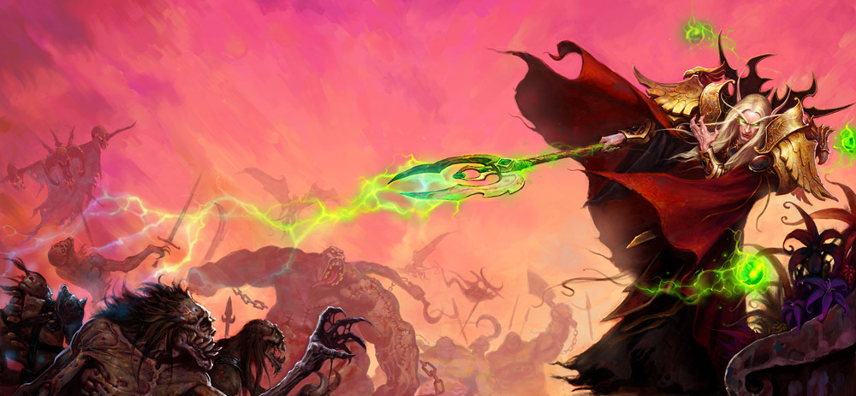
GA 4401 – Advanced Game Prototyping
http://www.gamasutra.com/view/feature/130848/how_to_prototype_a_game_in_under_7_.php
Week 6
Juicy Gameplay, and rapid prototyping

Slide 2
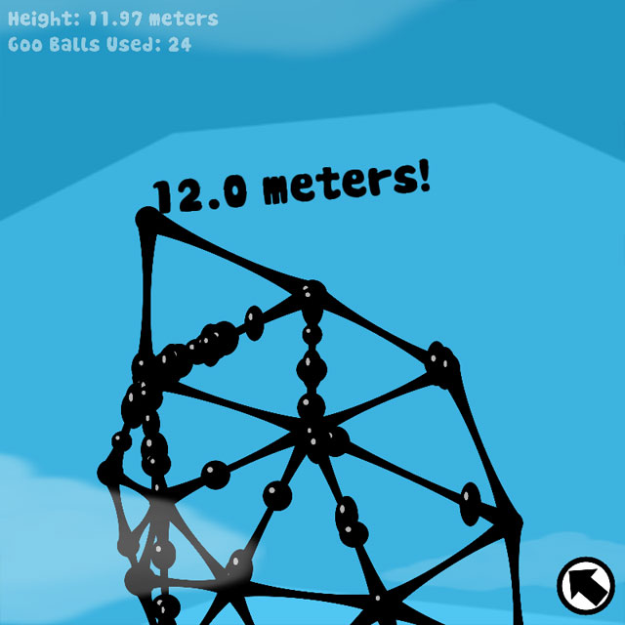
Tower of Goo
Notes:
Rapid prototyping is more than just a useful tool in pre-production – it can be a way of life! This section will show how to set up and begin thinking like a rapid prototyper.

Slide 3
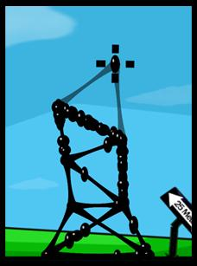
Setup: Rapid is a State of Mind
"Tower of Goo" was downloaded over 100,000 times within months of hitting the net.
Notes:
Here's a crazy game idea: Drag trash-talkin' gobs of goo to build a giant tower higher and higher. They squirm and giggle and climb upward over the backs of their brothers, but be careful! A constant battle against gravity, if you build a tower that's too unstable, it will all fall down.
"Tower of Goo" was downloaded over 100,000 times within months of hitting the net, it was dubbed “Internet Game of the Month” in one magazine, it was demoed on G4 and at the Experimental Gameplay Workshop at GDC, and it was one of over fifty games we made as a part of the Experimental Gameplay Project at Carnegie Mellon's Entertainment Technology Center.
And like the rest of them, it was made in under a week, by one person.
The project started in Spring 2005 with the goal of discovering and rapidly prototyping as many new forms of gameplay as possible. A team of four grad students, we locked ourselves in a room for a semester with three rules:
1. Each game must be made in less than seven days, 2. Each game must be made by exactly one person, 3. Each game must be based around a common theme i.e. "gravity", "vegetation", "swarms", etc.
"Tower of Goo" was downloaded over 100,000 times within months of hitting the net.
As the project progressed, we were amazed and thrilled with the onslaught of web traffic, with the attention from gaming magazines, and with industry professionals and academics all asking the same questions, "How are you making these games so quickly?" and "How can we do it too?"
We lay it all out here. Through the following tips, tricks, and examples, we will discuss the methods that worked and those that didn't. We will show you how to slip into a rapid prototyping state of mind, how to set up an effective team, and where to start if you've thought about making something new, but weren't sure how. We hope these well-tested guidelines come in useful for you and your next project, big or small!
For easy browsing, all tips and tricks are organized into four sections: Setup, Design, Development, and General Gameplay. Enjoy!

Slide 4
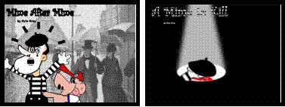
Embrace the Possibility of Failure - it Encourages Creative Risk Taking
"Mime After Mine" and "A Mime to Kill" - warmly embracing failure.
Notes:
Failure is ok! Like going to a new restaurant instead of mcdonalds every time. If you fail, there are dozens more chances!

Slide 5
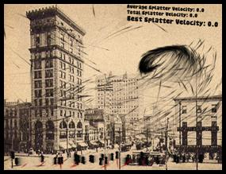
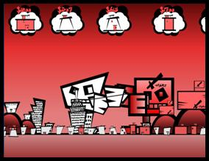
Enforce Short Development Cycles (More Time != More Quality)
Attack of the Killer Swarm” (left) took just a day to throw together and surprisingly became one of the highest rated games of the project. “Suburban Brawl” (right) received an extra week of love but became so convoluted it probably would have been more fun without the addition of giant killer robots – which wasted both cities and time alike.
Notes:
Spending twice as long on a game doesn’t mean it’s twice as good. There isn’t really a correlation between spending more time on a game and better quality

Slide 6
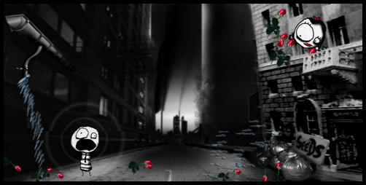
Constrain Creativity to Make You Want it Even More
“Gravity Head” – use your gravity-powered head to grow and deliver.
Notes:
Constraints help you be creative!
“gravity”, “springs”, “evolution”, “sound”, “predator and prey”, “addictive games”, “drawing”, “exponential growth”, “vegetation”, “balance”, and a few others individually.

Slide 7
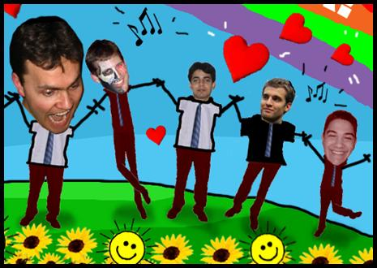
Gather a Kickass Team and an Objective Advisor – Mindset is as Important as Talent
“Our team, Experimental Friends 4 Ever!
Notes:
Design is paramount, even though you’re responsible for everything

Slide 8
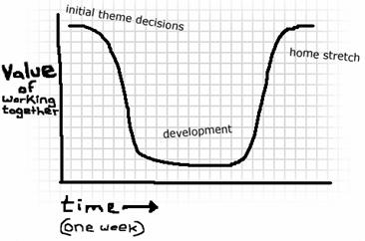
Develop in Parallel for Maximum Splatter
Notes:
The Graph
Risk mitigation
Friendly competition
Wider thematic exploration
Sharing and caring

Slide 9
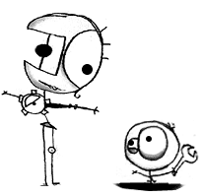
Design: Creativity and the Myth of Brainstorming
Notes:
Can’t force creative ideas out.

Slide 10
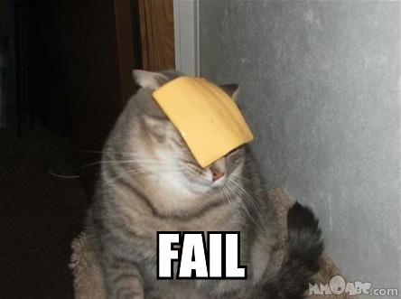
Formal Brainstorming Has a 0% Success Rate
Notes:
The best ideas come when you least expect them

Slide 11
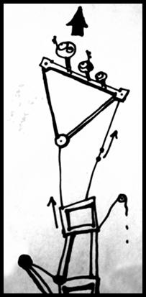
Gather Concept Art and Music to Create an Emotional Target
Tango music and little men climbing higher and higher...
http://www.youtube.com/watch?v=RUAPf_ccobc
Notes:
A strong mood and emotional feeling can be really helpful

Slide 12
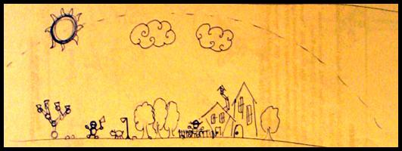
Simulate in Your Head – Pre-Prototype the Prototype
An early paper prototype for "On a Rainy Day" - helpful while simulating in your head.
Notes:
Imagine your audience saying “Wow!’
Thought experiments
Paper prototypes

Slide 13
Development: Nobody Knows How You Made it, and Nobody Cares

Slide 14
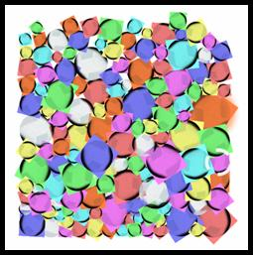
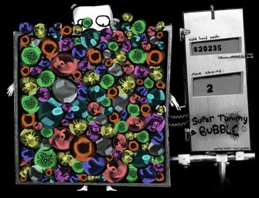
Build the Toy First
"Super Tummy Bubble" - Toy (left) vs. Final Prototype (right).
Notes:
Start with the core mechanic first, without any goals or decisions

Slide 15
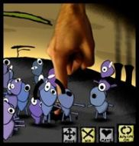
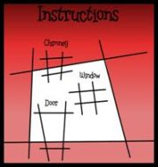

If You Can Get Away With it, Fake it
"Darwin Hill," "Suburban Brawl," "Tower of Goo" - all faked, and nobody noticed. Shhh!
Notes:
The correct solution is often not the best solution in prototyping
Lighting/shadowing, pattern recognition, splines, etc

Slide 16
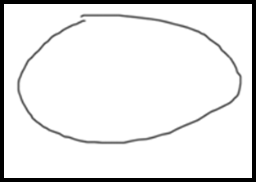
Cut Your Losses and "Learn When to Shoot Your Baby in the Crib"
"Matt's Potato" - bask in its glory.
Notes:
Realize when a game isn’t fun early, or else you’ll waste a bunch of time

Slide 17
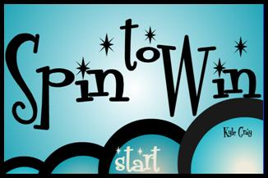
Heavy Theming Will Not Salvage Bad Design (or "You Can't Polish a Turd")
"Spin to Win" - all dressed up with nowhere to go.
Notes:
Gamers are smarter than you think and can tell when you’re bs’ing them

Slide 18

But Overall Aesthetic Matters! Apply a Healthy Spread of Art, Sound, and Music
An unrealeased prototype - art doesn't have to be complicated to feel compositionally solid
Notes:
Polishing an already fun mechanic as the ability to make a good game great.
Doesn’t need fancy graphics, just needs to mesh well

Slide 19
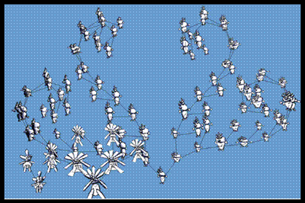
Nobody Cares About Your Great Engineering
"Evolution Trees" - all that technology doesn't add up to fun.
Notes:
Goal is to come up with several ways to solve something, and pick one. Fast

Slide 20
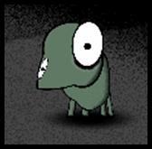
General Gameplay: Sensual Lessons in Juicy Fun

Slide 21
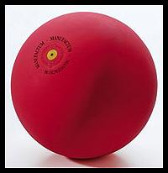
Complexity is Not Necessary for Fun
A rubber ball. Watch out, 3D technology!
Notes:
Ball on a flat surface has been fun for centuries
It’s entirely possible to have fun with basic concepts lke tetris, pac-man, etc.
New technologies are cool, but aren’t necessary most of the time

Slide 22
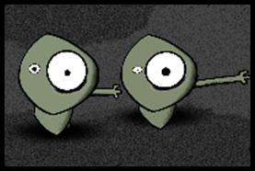
Create a Sense of Ownership to Keep 'em Crawling Back for More
"Darwin Hill" - everyone unique in their own special way.
Notes:
Creation or customization aspect appeals to the player
IE: Cell phone wallpapers and character creation

Slide 23
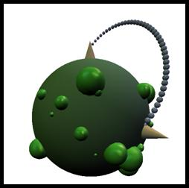
"Experimental" Does Not Mean "Complex"
"Spaceball Munch" - How can we know?!
Notes:
Minimize confusion for first few minutes of gameplay

Slide 24
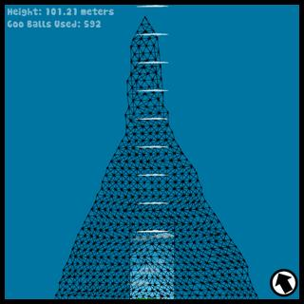
Build Toward a Well Defined Goal
"Tower of Goo" - building toward a goal... and beyond!
Notes:
Some people enjoy having opportunities to fail
It can be anything really

Slide 25
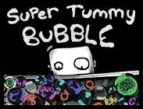

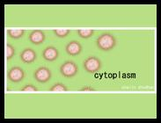
Make it Juicy!
Juice feels great! You can't keep your hands out of it.
Notes:
“Juice” was our wet little term for constant and bountiful user feedback. A juicy game element will bounce and wiggle and squirt and make a little noise when you touch it. A juicy game feels alive and responds to everything you do – tons of cascading action and response for minimal user input. It makes the player feel powerful and in control of the world, and it coaches them through the rules of the game by constantly letting them know on a per-interaction basis how they are doing.
Alien Hominid – enemies exploding and flinging blood to an almost unjustified extent
Mario Bros. – bouncing through a room full of coins, blinging with satisfaction
Pachinko - a never-ending gush of balls all under your control
Super Puzzle Fighter II Turbo – animation and sprites abound on multiple chains

Slide 26
More Juice!
http://grapefrukt.com/f/games/juicy-breakout/
http://www.youtube.com/watch?v=Fy0aCDmgnxg

Slide 27
New Groups!
Le, Dan Khac
Velasquez, Kimberly
Clark, James Donald
Trodick, Kristian S
Merola, Anthony Nicholas
Wheeldon, Chad Everett
Estrada Lucero, Emilio
Scott, Blair Louise
Vasquez, Daniel Jesus
Roberts, Alicia M
Guevara, Miguel Angel
Bauer, Colin Andrew

Slide 28
Themes!
Caverns
Burrowing
Castle
Clouds
Connections
Winds
Cold and Frozen
Evolution
Town
Herding
Flow
Glow in the dark
Flashlight
Role Reversal
Zombies
Recycling

